Slide 1
Android Programming
CMP SCI 4020/5020
Spring 2019

Slide 2
What is Expected
You should know how to program in Java
This is not a Java class and I am not going to teach you Java...but
We will come across a lot of Java by using/learning Android frameworks
This is still essential even though we will use Kotlin instead

Slide 3
What is Expected
You will need access to a computer that has Android Studio 3.x (hopefully 3.2/3.3)
Your projects will be actual applications that you will submit to me
You should know the basic concepts of Object Oriented Programming

Slide 4
What is Expected
You will spend a good amount of time on some of these projects (10+ hours per project)
You will have to do some research
You are expected to ask me questions whenever!

Slide 5
Quick Overview
Android was NOT Google
Google bought the company in 2005
First public android device released released in 2008 - HTC Dream (T-Mobile G1)
Ran Android version 1.5 “Donut”

Slide 6
Version names
Google uses a “confection” naming method
1.5 Cupcake
1.6 Donut
2.0-2.1 Eclair
2.2 FroYo (Frozen Yogurt)
2.3 Gingerbread
3.0 Honeycomb
4.0 Ice Cream Sandwich
4.1-4.3 Jelly Bean
4.4 Kit Kat
5.0-5.1 Lollipop
6.0 Marshmallow
7.0 Nougat
8.0-8.1 Oreo
9.0 Pie

Slide 7
Core Android
Android is based on a linux kernel
Uses Garbage collection
Main hardware is ARM but supports x86 and MIPS architectures (32-bit and 64-bit as well)
Uses either the Dalvik engine or Android Runtime (there are some major changes here)
Dalvik Engine is only on OS versions < 5.0 (4.4 was experimental)

Slide 8
Dalvik
Is at its basic level, a JVM
Programs are compiled to Java byte code and then translated for dalvik to read
Files stored as .dex or .odex
Has a maximum limit of methods - 65536 to be exact
Can be addressed with multi-dex applications
Uses JIT Compilation (Just In Time)

Slide 9
Android Runtime (ART)
Replaces Dalvik starting with Kit Kat (experimental)
Is now the default runtime for android versions > 5.0
Much better garbage collection
Better memory management
Better battery life

Slide 10
Android Runtime (ART)
uses AOT Compilation (Ahead of time)
Takes up more storage space vs. JIT
7.0 includes some JIT abilities for performance increases
Uses the same .dex file but has .elf replacing .odex
Also limited by 65K methods

Slide 11
Dalvik Virtual Machine
vs
Android Runtime
Dalvik only used JIT compilation
Code is compiled to native in chunks and when needed
Compilation happens during runtime
Lots of dynamic translation
ART uses AOT compilation
Code is fully compiled to native
Larger binaries
Static translation

Slide 12
Comparison

Slide 13
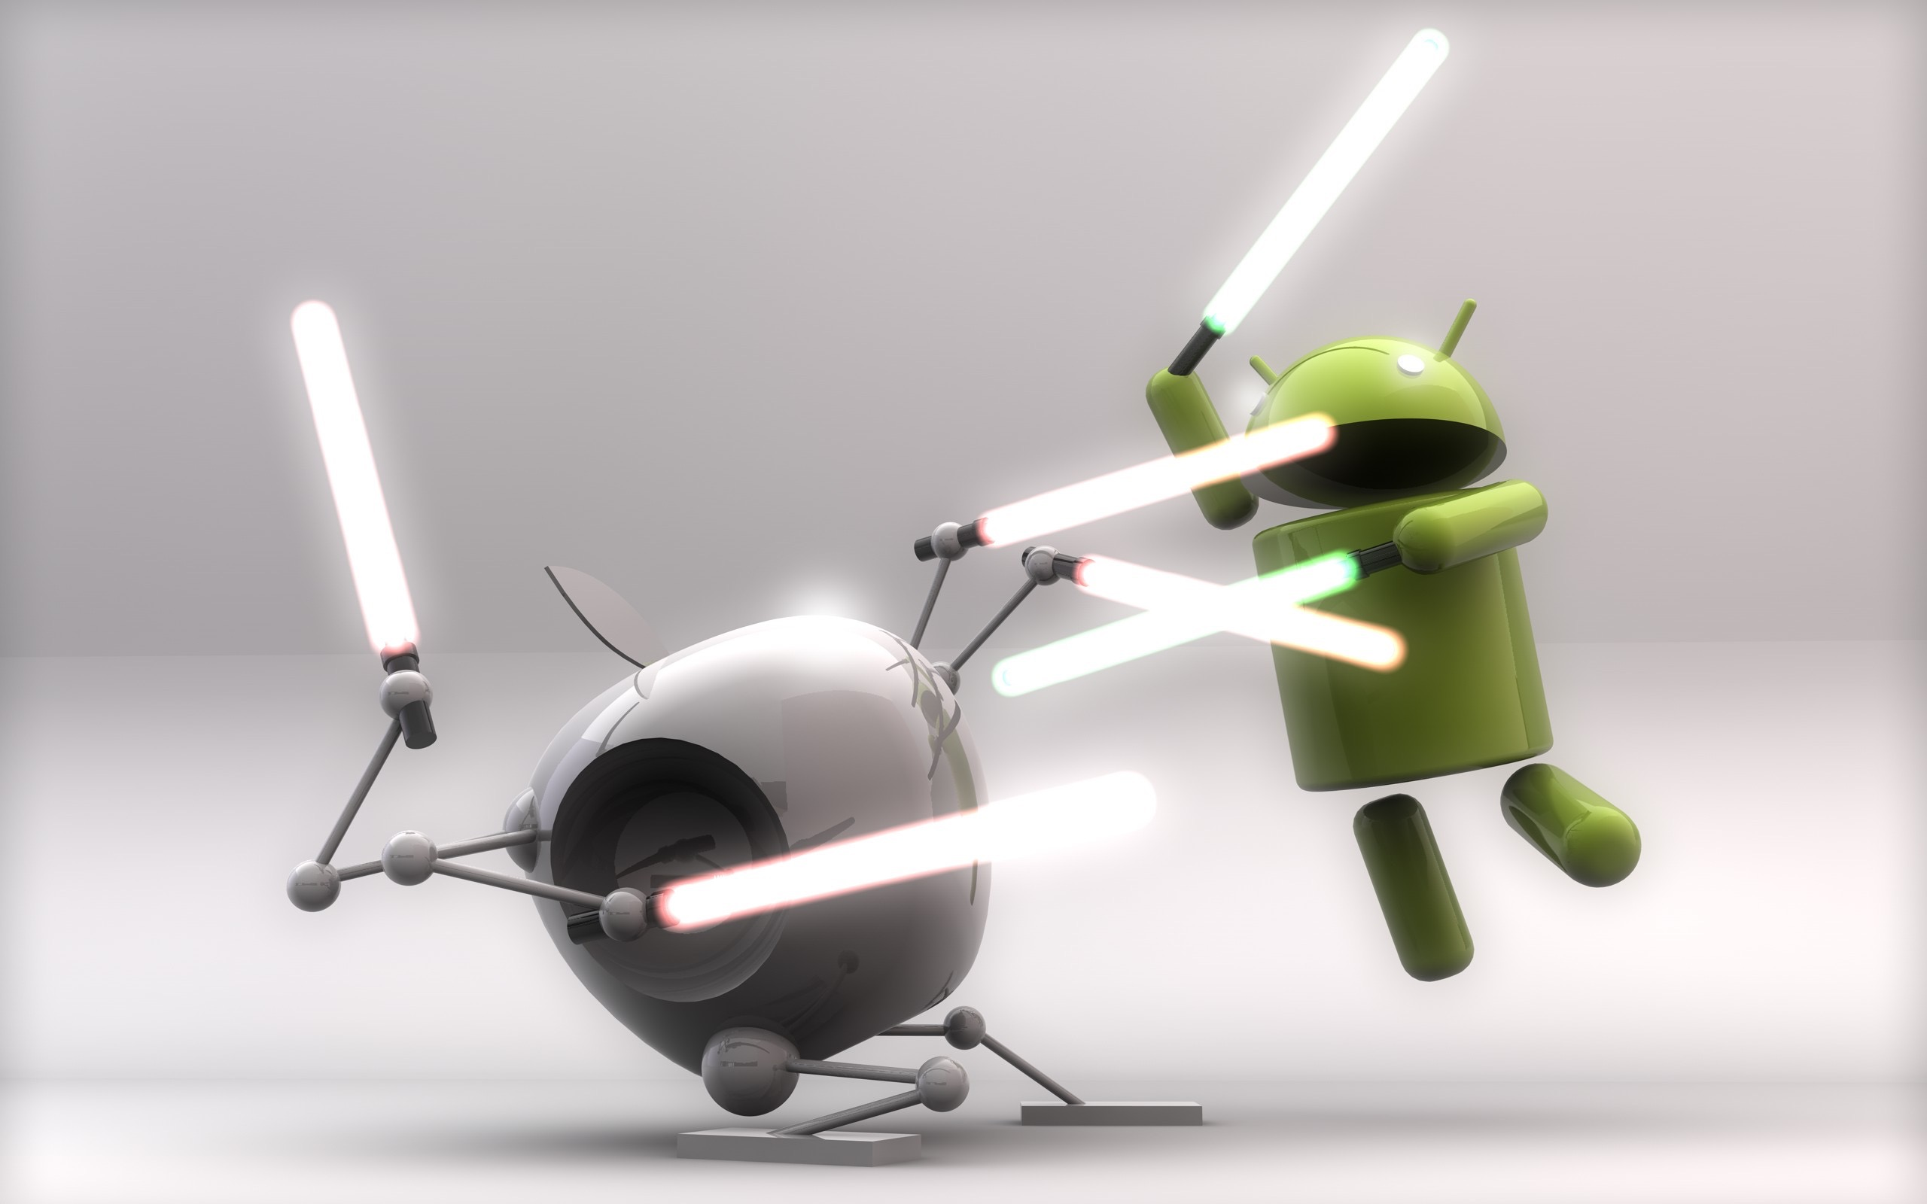
The Mobile Wars

Slide 14
Android’s Greatness
HUGE market share: ~75% worldwide
42.7% vs 56.9% iOS US Market share (http://gs.statcounter.com/os-market-share/mobile/worldwide)
37% to 63% iOS US Market share (https://deviceatlas.com/blog/android-v-ios-market-share#us)
Open Source!
Lots of options when selecting a device
Developers tend to love open platforms

Slide 15
“Religious” Wars
Tabs or Spaces?
Which language to start programming with?
Android or iOS?
Mac or PC?
Objective-C or Swift?
Java or Kotlin?
Java or Scala?
Java or Python?

Slide 16
It Really Doesn't Matter
This is all (in the end) personal preference
You are in this class to learn android and kotlin
If you would rather learn iOS, I will see you in the fall!
The focus should be how you write “good code” and not “use 2 tab spaces instead of 4”
You should use what you are most comfortable with
~ end tangent

Slide 17
Android’s Issues
EXTREMELY FRAGMENTED!!!
Google’s biggest issue with the platform (still trying to fix…)
Open Source (yes this is good and bad)
An incredible amount of badly written apps
In comparison, Play store is far less monitored than Apple’s App Store
Results in very high chance of viruses or
apps that run the system to the ground
Too easy to root and gain access to everyone’s app data

Slide 18
Android Apps
Apps run in a sandbox
No one has access to it unless given
Apps can run services
Apps can run in the background (more limited now-a-days)
Apps can run while the device is sleeping
Apps pretty much act just like desktop apps at this point
As you can see, this could cause some serious issues….

Slide 19
Android Apps
Because of these issues, users had to have memory/battery managers in the past
Phones seem to die quicker based on the apps that were installed
It can be hard to find a good version of the app you are actually looking for
Honestly, iOS suffers from this last one as well despite apple reviewing them...

Slide 20
Good News!
Google has stepped up their game on this!
Battery/memory managers still exist but not really needed anymore
“Good apps” still hard to find tho….but that now plagues all app stores

Slide 21
Google's Response
Apps that have viruses don't last long
Apps are killed by the OS typically if it takes too many resources
Google tried to fix code issues with AppCompat
Might have ACTUALLY fixed with Jetpack (We shall see)
Incorporates AppCompat so works with older platform versions

Slide 22
Creating Android Apps
Can use most Java IDEs:
Android Studio (what we will use)
IntelliJ (Android Plugin)
Eclipse
NetBeans (NBAndroid)
Can use a text files……but why?

Slide 23
Creating Android Apps
Build is done using Gradle
This is the default for Android Studio
Gradle is similar to maven or Node.js's NPM
Builds can be done using Ant as well
I believe the other IDE’s may use this still
We won’t use this however

Slide 24
Android ADB
Android Debug Bridge
What is used to install the apps on your device
Also what is used when rooting to gain access to the filesystem
You will see this running in Logcat
Basically, this is a UNIX shell for Android
You can run command line directly on your device with this
This will allow you to push and pull data to your phone/tablet

Slide 25
Where to find Information
You have a few resources:
Books (Big Nerd Ranch, Kotlin for Android, etc.)
Kotlin for Android: will be your go-to for Kotlin conversions for android if you decide to pick it up
Google is your friend
Google has a plethora of documents on Android but can be difficult to read at first
Stack Overflow is a good site but be careful here and choose wisely
I will post everything I can
All code is yours to read, modify, use (just not copied into your projects)

Slide 26
Quick Getting Started
Android creates the default project structure for you
You will have:
.kt files or .java class files
.xml files
.gradle files
.properties files
.png, .svg files

Slide 27
Android Manifest
AndroidManifest.xml
This is basically your project outline and settings file
Any “Activity” will need to be added here
uses permissions
services
requirements

Slide 28
build.grade
There are two in the project
Module and Project
Module defines the following:
Libraries to compile (dependancies)
min/max SDK version
appID
appVersion

Slide 29
/res directory
Composed mostly of .xml and .png files
Where you build:
Layouts, custom drawings,
images, strings, styling, colors,
dimens (dimensions file)
Will define your layout based on screen size, density, orientation, etc.
Java classes will use these to wire-up your interface to code

Slide 30
/java directory
where your app packages live
uses “reversed” domain naming convention (common in any Java)
The classes that will be compiled into the .apk file as byte code/native code
Most of your time is spent here after you've defined your layouts in the /res directory
Both Java and Kotlin files live in this directory

